Slide 1

PDAS Ca2 as a potential car buyer, What factors contribute to owning a car in sg? an analysis on Singapore Transport data
Justin wong juin hng (p2112646)

Slide 2
Objectives
In-depth walkthrough of the cleaning of given dataset(s)
Explain the purpose of dataset(s) analysis
Description of specific dataset(s) and related analyses
Analysis of insights gathered from dataset(s)
Credits

Slide 3
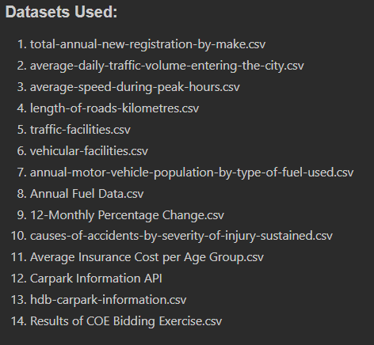
dataset(s) used

Slide 4
Objective of data analysis
As a potential car buyer in Singapore, I am looking at:
What road facilities am I provided with as a car buyer?
What are the most common accidents? If I get into an accident, what are the average vehicle insurance prices
How much are average fuel prices?
How congested is Singapore? How many cars are on the road and how fast can I drive?
After I’m done driving, where do I park my car?
What are the most popular brand of cars sold and their respective models? How much do I have to pay for COE?
1
2
3
4
5
6

Slide 5
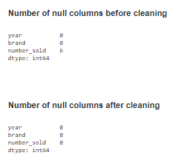
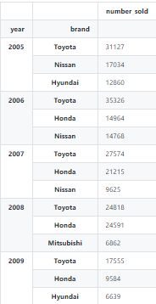
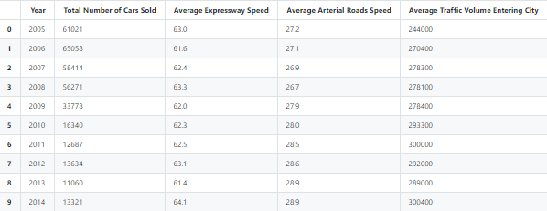
Data cleaning & Wrangling
Datasets: 1,2,3
Import
Import raw data from .CSV file
Clean
Assign names and labels
Declare
Declare arrays to store column-specific data
Store
Store column-specific data in arrays
Display
Display data for ease of viewing
Write
Write cleaned data to new .csv file for DAVI
df1 = pd.read_csv(r'./Datasets/(1) annual-new-registrations-of-cars-by-make/(1) total-annual-new-registration-by-make.csv') df1 = df1.rename(columns = {'make':'brand','number':'number_sold'}) display(df1.isna().sum()) df1 = df1.fillna(0) df2 = df1 df2 = df2.fillna(0) df3 = df2.groupby('year').head(3) df3 = df3.astype({"number_sold": int}) df3.to_csv('./Datasets/(1) cleaned.csv') display(df1.isna().sum())
display(df3.set_index(['year','brand'])) unique_values = df1['year'].unique() df4 = df3.reset_index() mean_values = [[i] for i in unique_values] i=0 for year in mean_values: mean_values[i].append(int(round(df4.loc[df4['year']==unique_values[i]]['number_sold'].sum()))) i = i+1 df5 = pd.DataFrame(data=mean_values,columns=['Year','Total Number of Cars Sold']) df6 = pd.read_csv(r'./Datasets/(2) road-traffic-conditions/(3) average-speed-during-peak-hours.csv’)
df7 = pd.read_csv(r'./Datasets/(2) road-traffic-conditions/(2) average-daily-traffic-volume-entering-the-city.csv’)
df7.to_csv('./Datasets/(2) cleaned.csv') df6.to_csv('./Datasets/(3) cleaned.csv') df6 = df6.rename(columns={'ave_speed_expressway':'Average Expressway Speed','ave_speed_arterial_roads':'Average Arterial Roads Speed','year':'Year'}) df7 = df7.rename(columns={'ave_daily_traffic_volume_entering_city':'Average Traffic Volume Entering City','year':'Year'}) df_list = [df5,df6,df7] df_final = reduce(lambda left,right: pd.merge(left,right,on='Year'), df_list) #merge data using lambda function df_final.to_csv('./Datasets/Cleaned Data/(1,2,3) cleaned.csv’)
display(df_final)
fillna(0) to fill null values with 0
set_index() to format for viewing
pd.DataFrame() to initialize DataFrame
reduce(lambda left,right: pd.merge(left,right,on='Year'), df_list) to merge datasets together
read_csv() & to_csv() to read the original data and write the cleaned data for DAVI visualization analysis
m = min(i for i in np.array([]) if i > 0) sorting with list comprehension.
m = min(i for i in np.array(df1[df1['year']==year]['number_sold']) if i > 0)

Slide 6

Explanation of insights
There were 6 empty columns in number sold, hence they were filled with a 0 value to ensure that the total number of brands were counted correctly. There were not filled with a string as ‘number_sold’ in an integer type, and it made the most sense to fill it in as such.
From 2005 to 2017, the most popular brand was Toyota. However, the third and second places are constantly changing, ranging from Nissan, Honda, Mazda and even luxury vehicles such as BMW and Mercedes.
From 2005 to 2017, even though the number of cars sold per year decreased, the average traffic volume entering the city increased. This suggests that car buyers in Singapore prefer to hold on to their vehicles as they retain their practical value.
In addition, average expressway and arterial road speeds increased by an average of 1.4km/h, suggesting that cars are driving at a faster speed due to greater availability of traffic facilities to reduce congestion e.g. more highways being built.

Slide 7
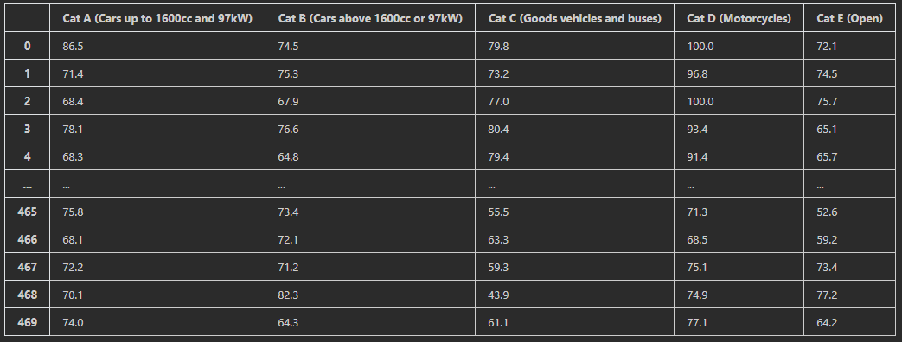
Data cleaning & Wrangling
Dataset:14
Import
Import raw data from .CSV file
Clean
Assign names and labels
Declare
Declare arrays to store column-specific data
Store
Store column-specific data in arrays
Display
Display data for ease of viewing
Write
Write cleaned data to new .csv file for DAVI
display(df21.isna().sum()) #%% df21['Quota Premium'] =df21['Quota Premium'].replace({'\$': '', ',': ''}, regex=True)
#clean data using regex and replace functions to remove currency formatting df21 = df21.drop(['Bidding Exercise', 'Announcement Date'], axis=1) df21 = df21.set_index(['Year', 'Category']) cols = df21.columns.tolist() print(cols) df21['Quota Premium'] = df21['Quota Premium'].astype(int) df21 = df21.reset_index() g = sns.boxplot(x='Category', y='Quota Premium', data=df21) plt.show() categories = np.unique(df21['Category']) success_rate ={} premium_dev ={} premium_dev_currency = {} display(df21) for category in categories: print(category) list_values = [] list_values_percentage = [] success = np.array(df21[df21['Category']==category]['Number of Successful Bids']) total = np.array((df21[df21['Category']==category]['Total Bids Received'])) for x,y in zip(success,total): list_values.append(round((x/y*100),1)) success_rate[category]=list_values premium_dev[category]=round(df21[df21['Category']==category]['Quota Premium'].std(),2) premium_dev_currency[category]="${:,.2f}". format(round(df21[df21['Category']==category]['Quota Premium'].std(),2)) percentage_stacked_df = pd.DataFrame(success_rate) premium_dev_currency = pd.Series(premium_dev_currency) premium_dev = pd.Series(premium_dev) success_rate = round(percentage_stacked_df.std(),1) display(percentage_stacked_df) print('Standard Deviation for COE Premiums:') display(premium_dev_currency) print('\nStandard Deviation for COE Success Rate:') display(success_rate) df21.to_csv('./Datasets/Cleaned Data/(14) All Combined cleaned.csv') percentage_stacked_df.to_csv('./Datasets/Cleaned Data/(14) Bid Success Rate All Years cleaned.csv') premium_dev.to_csv('./Datasets/Cleaned Data/(14) COE Premium Standard Deviation cleaned.csv') success_rate.to_csv('./Datasets/Cleaned Data/(14) Bid Success Rate Standard Deviation cleaned.csv') plt.show()
astype() to set datatype
pd.DataFrame() to initialize DataFrame
.replace({'\$': '', ',': '', regex=True} to get rid of currency and thousand’s formatting with regex searching
for x,y in zip(success,total) to utilize both datasets together to calculate percentage success rate for COE bidding application
read_csv() & to_csv() to read the original data and write the cleaned data for DAVI visualization analysis

Slide 8
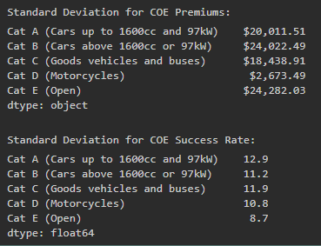
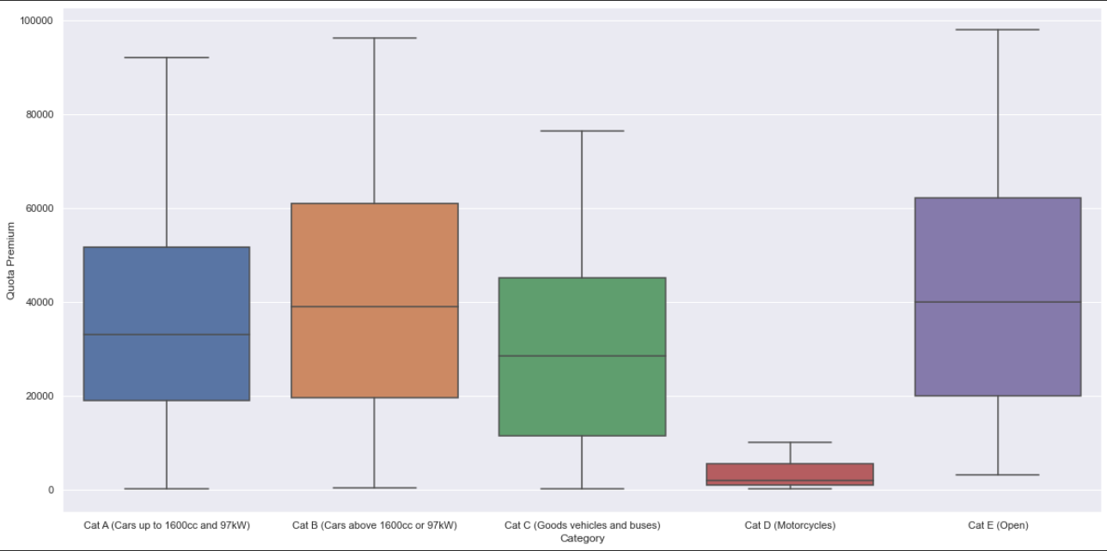
Explanation of insights
There were columns where the dataset had special characters such as dollar signs ($) and commas (,). To get rid of this, I used the .replace() function alongside regex to ensure that all the weird formatting of data was cleansed and ready to be wrangled
After cleansing the data, I plotted the distribution of prices per category, Cat A, B, C , D and E to view the trend of COE Premiums for each category and formatted it with ($) and (,) respectively.
As we can see, cat E has the largest interquartile range, and the greatest standard deviation, indicating that the central portion of the data spread out further and that the COE Premiums for cars within Cat E are incredibly inconsistent, suggesting internal market volatility, as is the case for additional premiums incurred for the privilege choosing any type of vehicle, which can add lots of variability in terms of vehicle brands, models and vehicle category type
For Cat D, the motorcycles, we can see that the distribution for the COE Premiums for motorcycles is a lot smaller in terms of interquartile range, and they come in the lowest in terms of standard deviation. This can mean that the COE premiums for motorcycles are often fixed and non-negotiable, suggesting that there is market stability for the sales of motorcycles and their respective COE premiums due to their low interquartile range and standard deviation
The category with the largest interquartile range is Cat B, for cars above 1600cc or 97kW, often associated as family cars and luxury cars. Due to the ambiguity and range of features offered in car models in Cat B, this creates a more volatile and unstable market, which applies itself similarly to its respective COE Premiums, coming in a close second in standard deviation for COE Premiums.

Slide 9
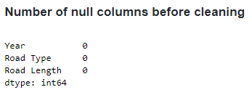
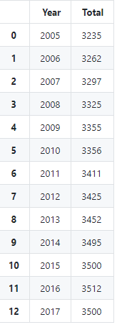
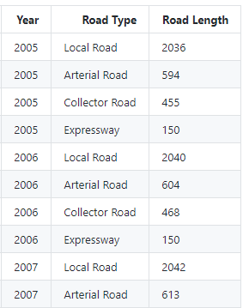
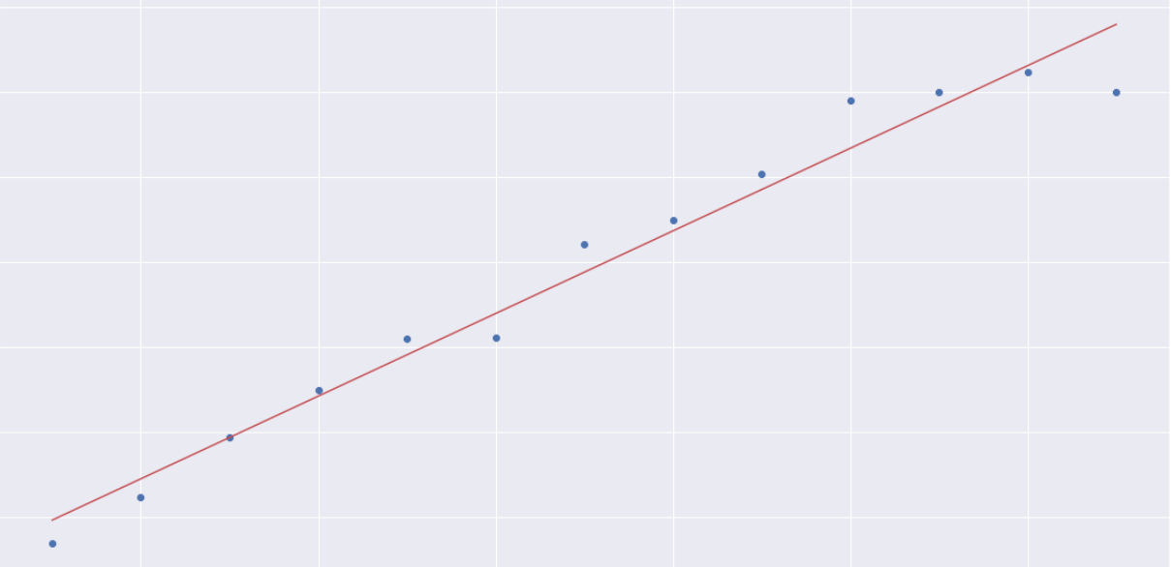
Data cleaning & Wrangling
Dataset: 4
Import
Import raw data from .CSV file
Clean
Assign names and labels
Declare
Declare arrays to store column-specific data
Store
Store column-specific data in arrays
Display
Display data for ease of viewing
Write
Write cleaned data to new .csv file for DAVI
#print data analysis output print(stockModel.params) print(stockModel.summary()) x=df8_total['Year'] y=df8_total['Total'] plt.scatter(y=y, x=x)
# best fit line Y = C + M * X m,c = np.polyfit(x, y, deg=1) plt.plot(x, c+m*x, 'r-’) plt.xlabel('Year') plt.ylabel('Total') plt.show()
f8 = pd.read_csv(r'./Datasets/(2) road-traffic-conditions/(4) length-of-roads-kilometres.csv') df8 = df8.rename(columns={'year':'Year','road_type':'Road Type','road_length':'Road Length'}) df8.to_csv('./Datasets/Cleaned Data/(4) cleaned.csv') display(df8.isna().sum()) display(df8) total_road_length_keys = (np.unique(df8["Year"])) total_road_length_values =[] for year in np.unique(df8["Year"]): total_road_length_values.append(df8[df8["Year"]==year]["Road Length"].sum()) total_road_length = dict(zip(total_road_length_keys, total_road_length_values)) df8_total = pd.Series(data=total_road_length, index=np.unique(df8["Year"])) df8 = df8.set_index(['Year','Road Type']) df8_total = df8_total.to_frame().reset_index() df8_total = df8_total.rename(columns={0:'Total','index':'Year'}) df8_total.to_csv('./Datasets/Cleaned Data/(4) total_cleaned.csv’) display(df8_total) #check data fit stockModel = sm.OLS.from_formula("Total ~ Year", data=df8_total).fit() stockPredicts = stockModel.predict()
.isna().sum() to check for null values
np.unique(df["Year"]) to retrieve unique years
dict(zip()) usage of dict() and zip() functions to create dictionary with road length values
df_total.to_frame().reset_index() to create a DataFrame and reset its index
.rename(columns={0:'Total','index':'Year’}) to rename columns for ease of understanding
stockModel = sm.OLS.from_formula("Total ~ Year", data=df_total).fit(), stockPredicts = stockModel.predict()
To check fit of data using linear regression
read_csv() & to_csv() to read the original data and write the cleaned data for DAVI visualization analysis

Slide 10

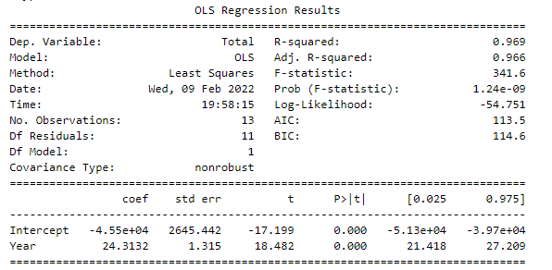
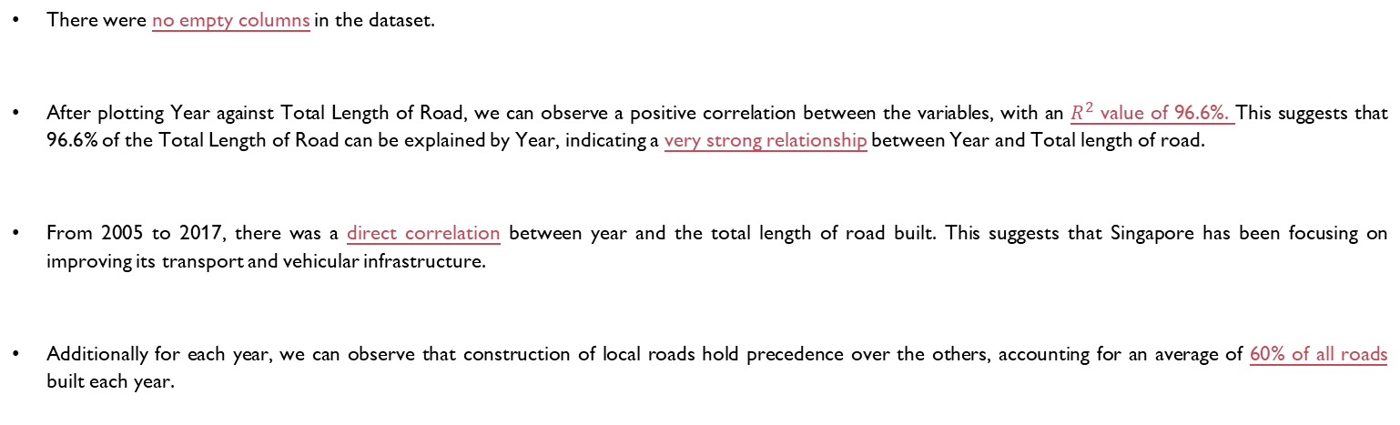
Explanation of insights
There were no empty columns in the dataset.
After plotting Year against Total Length of Road, we can observe a positive correlation between the variables, with an $R^{2}$ value of 96.6%. This suggests that 96.6% of the Total Length of Road can be explained by Year, indicating a very strong relationship between Year and Total length of road.
From 2005 to 2017, there was a direct correlation between year and the total length of road built. This suggests that Singapore has been focusing on improving its transport and vehicular infrastructure.
Additionally for each year, we can observe that construction of local roads hold precedence over the others, accounting for an average of 60% of all roads built each year.

Slide 11
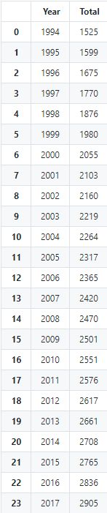
Data cleaning & Wrangling
Datasets: 5,6
Import
Import raw data from .CSV file
Clean
Assign names and labels
Declare
Declare arrays to store column-specific data
Store
Store column-specific data in arrays
Display
Display data for ease of viewing
Write
Write cleaned data to new .csv file for DAVI
df9 = pd.read_csv(r'./Datasets/(2) road-traffic-conditions/(5) traffic-facilities.csv') #import dataset 5 df10 = pd.read_csv(r'./Datasets/(2) road-traffic-conditions/(6) vehicular-facilities.csv') #import dataset 5 display(df9.isna().sum()) display(df10.isna().sum()) df9 = df9.rename(columns={'year':'Year','facility':'Type of Facility','number':'Count'}) #rename columns for easier readability df10 = df10.rename(columns={'year':'Year','facility':'Type of Facility','number':'Count'}) #rename columns for easier readability df_final = pd.concat([df9,df10]) #concatenate the 2 DataFrames for easier readability df_final = df_final.sort_values(by=['Year','Count']) df_final = df_final.reset_index() df_final = df_final.drop(columns=['index']) #clean final data display(df_final) total_typeof_keys = (np.unique(df_final["Year"])) total_typeof_values =[] for year in np.unique(df_final["Year"]): total_typeof_values.append(df_final[df_final["Year"]==year]["Count"].sum())
total_typeof = dict(zip(total_typeof_keys, total_typeof_values)) df_final_total = pd.Series(data=total_typeof, index=np.unique(df_final["Year"])) #make index using np.unique of years df_final = df_final.set_index(['Year','Type of Facility']) df_final_total = df_final_total.to_frame().reset_index() df_final_total = df_final_total.rename(columns={0:'Total','index':'Year'}) df_final.to_csv('./Datasets/Cleaned Data/(5,6) cleaned.csv') df_final_total.to_csv('./Datasets/Cleaned Data/(5,6) total_cleaned.csv') display(df_final_total) #check data fit stockModel = sm.OLS.from_formula("Total ~ Year", data=df_final_total).fit() stockPredicts = stockModel.predict() #print data analysis output print(stockModel.params) print(stockModel.summary()) x=df8_total['Year'] y=df8_total['Total'] plt.scatter(y=y, x=x) # best fit line Y = C + M * X m,c = np.polyfit(x, y, deg=1) plt.plot(x, c+m*x, 'r-') plt.xlabel('Year') plt.ylabel('Total') plt.show()
.isna().sum() to check for null values
np.unique(df["Year"]) to retrieve unique years
pd.concat([df,df]) to join the datasets for easier readability and functionality
df_total.to_frame().reset_index() to create a DataFrame and reset its index
dict(zip()) usage of dict() and zip() functions to create dictionary with road length values
.rename(columns={}) to rename columns for ease of understanding
stockModel = sm.OLS.from_formula("Total ~ Year", data=df_total).fit(), stockPredicts = stockModel.predict()
To check fit of data using linear regression
display() to view the DataFrame, Linear Regression Model and Lineplot
read_csv() & to_csv() to read the original data and write the cleaned data for DAVI visualization analysis

Slide 12
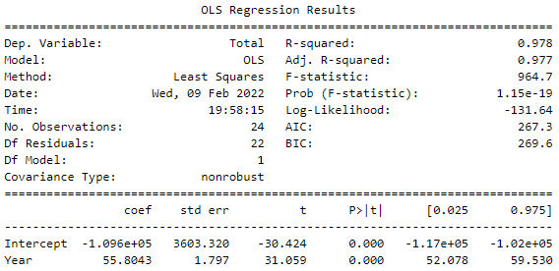
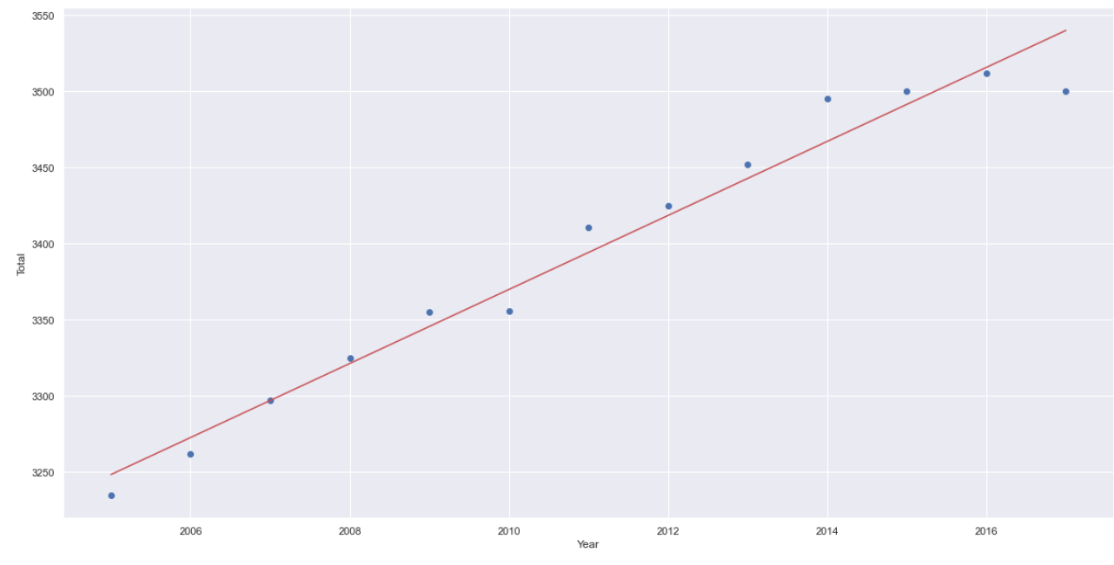
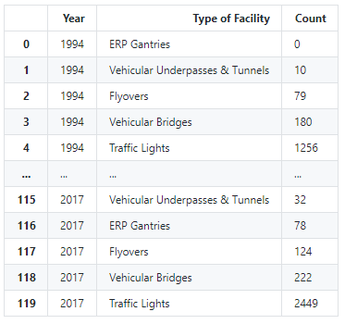
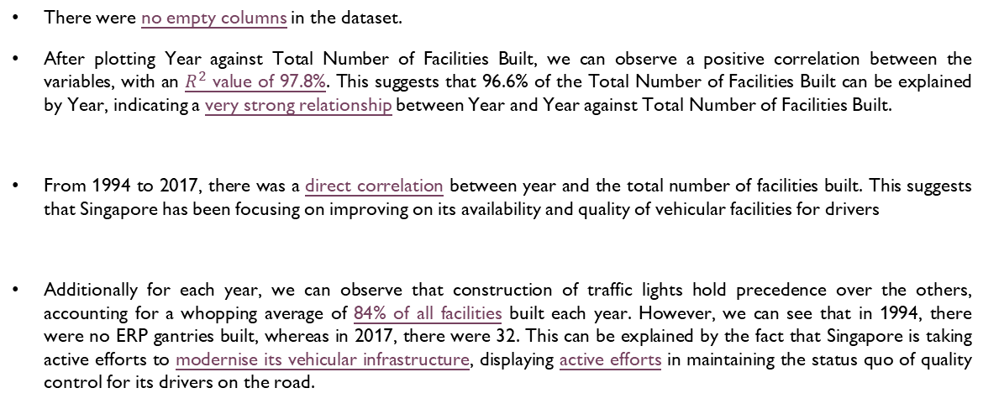
Explanation of insights
There were no empty columns in the dataset.
After plotting Year against Total Number of Facilities Built, we can observe a positive correlation between the variables, with an $R^{2}$ value of 97.8%. This suggests that 96.6% of the Total Number of Facilities Built can be explained by Year, indicating a very strong relationship between Year and Year against Total Number of Facilities Built.
From 1994 to 2017, there was a direct correlation between year and the total number of facilities built. This suggests that Singapore has been focusing on improving on its availability and quality of vehicular facilities for drivers
Additionally for each year, we can observe that construction of traffic lights hold precedence over the others, accounting for a whopping average of 84% of all facilities built each year. However, we can see that in 1994, there were no ERP gantries built, whereas in 2017, there were 32. This can be explained by the fact that Singapore is taking active efforts to modernise its vehicular infrastructure, displaying active efforts in maintaining the status quo of quality control for its drivers on the road.

Slide 13
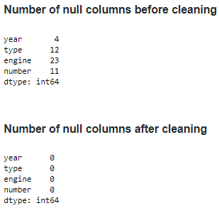
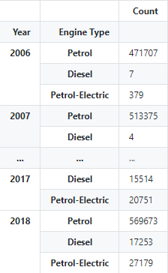
Data cleaning & Wrangling
Datasets: 7,8,9
Import
Import raw data from .CSV file
Clean
Assign names and labels
Declare
Declare arrays to store column-specific data
Store
Store column-specific data in arrays
Display
Display data for ease of viewing
Write
Write cleaned data to new .csv file for DAVI
df11 = pd.read_csv(r'./Datasets/(2) road-traffic-conditions/(7) annual-motor-vehicle-population-by-type-of-fuel-used.csv’) display(df11.isna().sum()) df11 = df11.dropna() df11 = df11.astype({"year": int}) df11 = df11.astype({"number": int}) display(df11.isna().sum()) df11 = df11.rename(columns={'year':'Year','engine':'Engine Type','number':'Count'}) df11 = df11.drop(df11[df11['type']!='Cars'].index) # only keep cars df11 = df11.groupby('Year').head(3) df11 = df11.drop(['type'], axis=1) df11 = df11.set_index(['Year','Engine Type']) df11.to_csv('./Datasets/Cleaned Data/(7) cleaned.csv') display(df11) df17 = pd.read_csv(r'./Datasets/(3) Fuel Data/(8) Annual Fuel Data.csv') df19 = pd.read_csv(r'./Datasets/(3) Fuel Data/(8) Annual Fuel Data Monthly.csv') display(df17.isna().sum()) df17 = df17.dropna() df17 = df17.astype({"Year": int}) display(df17.isna().sum()) df17.to_csv('./Datasets/Cleaned Data/(8) cleaned.csv') df19.to_csv('./Datasets/Cleaned Data/(8) monthly cleaned.csv') display(df17) display(df19) lineplot1 = sns.lineplot(data=df19) lineplot1.set(xticklabels=[0,1975,1985,1995,2005,2015]) plt.show() df18 = pd.read_csv(r'./Datasets/(3) Fuel Data/(9) 12-Monthly Percentage Change.csv') df20 = pd.read_csv(r'./Datasets/(3) Fuel Data/(9) Monthly.csv') display(df18.isna().sum()) df18 = df18.dropna() df18 = df18.astype({"Year": int}) display(df17.isna().sum()) df18.to_csv('./Datasets/Cleaned Data/(9) cleaned.csv') df20.to_csv('./Datasets/Cleaned Data/(9) monthly cleaned.csv') display(df18) display(df20) lineplot2 = sns.lineplot(data=df20) lineplot2.set(xticklabels=[0,1975,1985,1995,2005,2015]) plt.show()
.isna().sum() to check for null values
np.unique(df["Year"]) to retrieve unique years
pd.concat([df,df]) to join the datasets for easier readability and functionality
df_total.to_frame().reset_index() to create a DataFrame and reset its index
dict(zip()) usage of dict() and zip() functions to create dictionary with road length values
.rename(columns={}) to rename columns for ease of understanding
display() to view the DataFrame, Linear Regression Model and Lineplot
read_csv() & to_csv() to read the original data and write the cleaned data for DAVI visualization analysis
stockModel = sm.OLS.from_formula("Total ~ Year", data=df_total).fit(), stockPredicts = stockModel.predict()
To check fit of data using linear regression

Slide 14
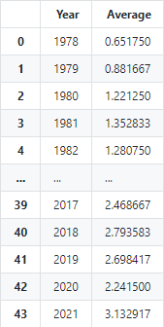
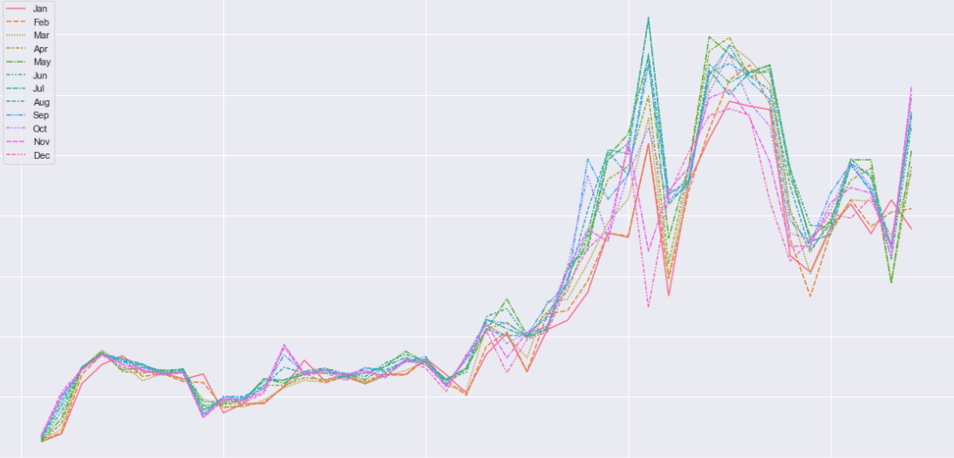
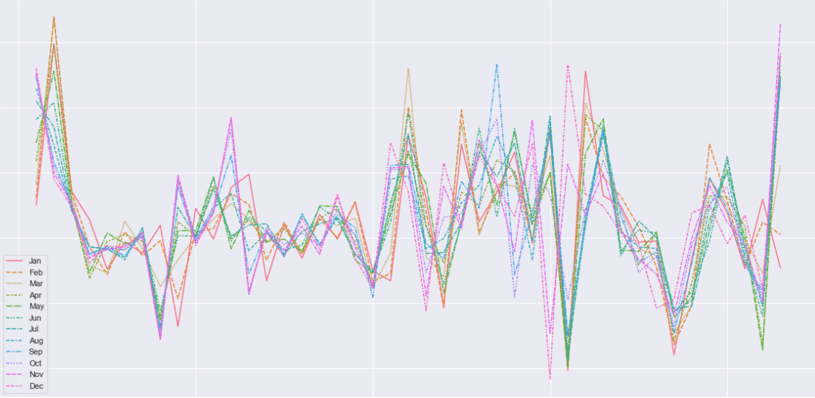
Explanation of insights
There were a total of 50 missing values in the dataset.
After plotting Year against Average Fuel Prices per Month, we can observe a positive correlation between the variables, with an observable upward trend.
From 1978 to 2021, there was a direct correlation between year and the Average Fuel Prices per Month. This suggests that the increase in fuel prices were due to Time. After being adjusted for inflation, we can see that there was a whopping 450% increase in fuel prices in the span of 44 years
Additionally for colour present on the chart, we can observe that fuel prices were the highest during the middle part of each year, with green-hue values such as May, June and July ranking at the top for all of the peaks. This suggests that demand increased during the middle parts of the year, but due to low supply, prices increased.
There were a total of 50 missing values in the dataset.
After plotting Year against % Difference per the Previous Month, we can observe almost no correlation between each the % difference going from month to month, with frequent spikes and dips over the span of 44 years.
This suggests that fuel prices are not only susceptible to market fluctuations and economic bubbles, the impact of such trends also trickle down into the unreliability and inconsistency of fuel prices, making it hard to predict future fuel prices as a consumer.

Slide 15
Data cleaning & Wrangling
Dataset: 10
Import
Import raw data from .CSV file
Clean
Assign names and labels
Declare
Declare arrays to store column-specific data
Store
Store column-specific data in arrays
Display
Display data for ease of viewing
Write
Write cleaned data to new .csv file for DAVI
df12 = pd.read_csv(r'./Datasets/(2) road-traffic-conditions/(10) causes-of-accidents-by-severity-of-injury-sustained.csv') display(df12.isna().sum()) df12 = df12.dropna() display(df12.isna().sum()) df_temp = df12.rename(columns={'year':'Year','road_user_group':'Road User Group','causes_of_accident':'Cause of Accident','number_of_accidents':'Number of Accidents’})
df_temp = df_temp.sort_values(by=['Year', 'Number of Accidents'],ascending=False)
df_temp = df_temp.astype({"Number of Accidents": int})
df_temp = df_temp.groupby(['Year','accident_classification']).first() # sort by the year then by the accident fatality display(df_temp) z_scores = stats.zscore(df12['number_of_accidents']) #use Z score to find outliers in data abs_z_scores = np.abs(z_scores).to_frame() filtered_entries = (abs_z_scores < 3).all(axis=1) df_keys = filtered_entries[filtered_entries==False].keys()
print('Outliers Detected: ‘)
for key in df_keys: print(f"Outlier: {int(df12.loc[key,'number_of_accidents'])} number of accidents at Index: {key}")
df12 = df12[filtered_entries] df12 = df12.rename(columns={'year':'Year','road_user_group':'Road User Group','causes_of_accident':'Cause of Accident','number_of_accidents':'Number of Accidents'}) df12 = df12.sort_values(by=['Year', 'Number of Accidents'],ascending=False) df12 = df12.astype({"Number of Accidents": int}) df12 = df12.groupby(['Year','accident_classification']).first() # sort by the year then by the accident fatality
display(df12) df12.to_csv('./Datasets/Cleaned Data/(10) cleaned.csv') comb_data = [df12['Number of Accidents'],df_temp['Number of Accidents'],] fig2, ax2 = plt.subplots() ax2.set_title('Comparative Boxplot') plt.show(ax2.boxplot(comb_data,vert=False,labels=('With outlier', 'Without outlier'))) fig1, ax1 = plt.subplots() ax1.set_title('Boxplot for Cleaned Data') plt.show(ax1.boxplot(df12['Number of Accidents'], vert=False))
.isna().sum() to check for null values
fillna(0) to fill null values with 0
np.unique(df["Year"]) to retrieve unique years
df_total.to_frame().reset_index() to create a DataFrame and reset its index
stats.zscore(df['number_of_accidents']) to find the Z score for each cell to measure outlier data
np.abs(z_scores).to_frame() to insert Z scores into DataFrame
(abs_z_scores < 3). (allaxis=1) to get rid of all outlier data with Z score >3
df12.groupby(['Year','accident_classification']).first() To sort by year then by accident fatality
.rename(columns={}) to rename columns for ease of understanding
display() to view the DataFrame, Linear Regression Model and Lineplot
read_csv() & to_csv() to read the original data and write the cleaned data for DAVI visualization analysis

Slide 16
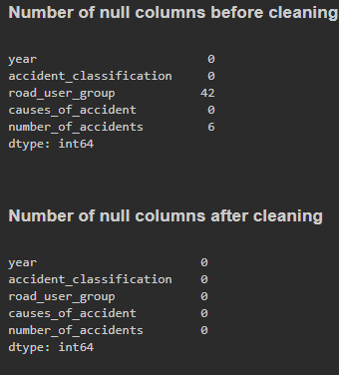
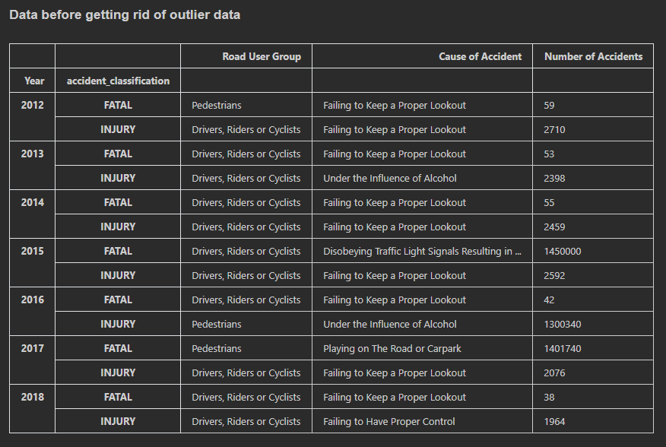
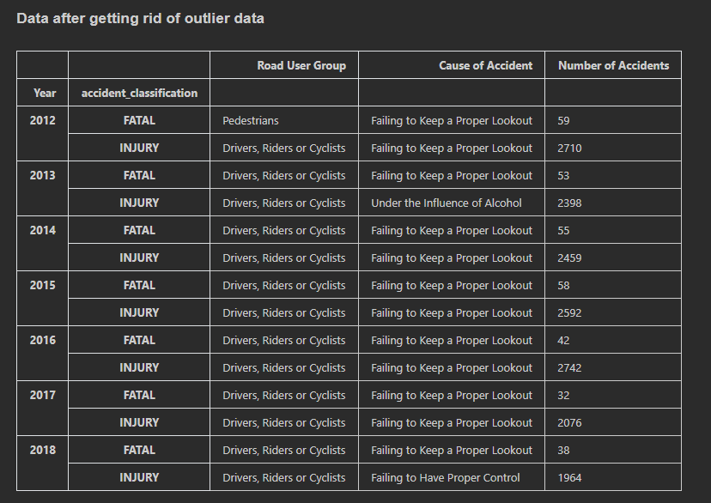
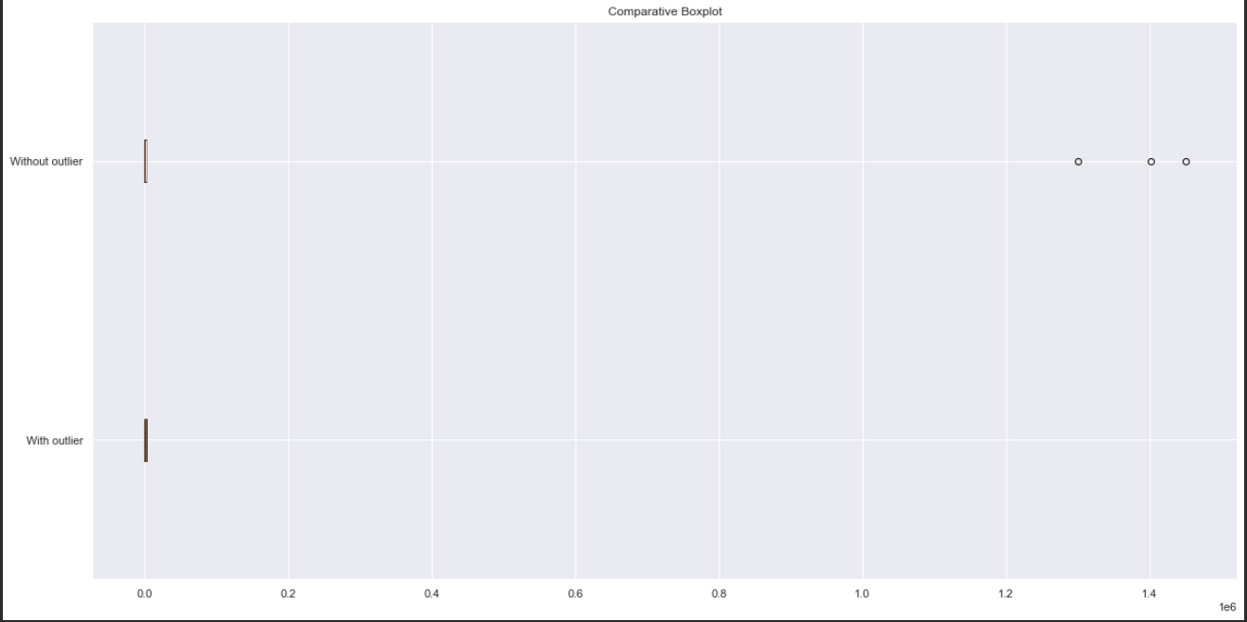
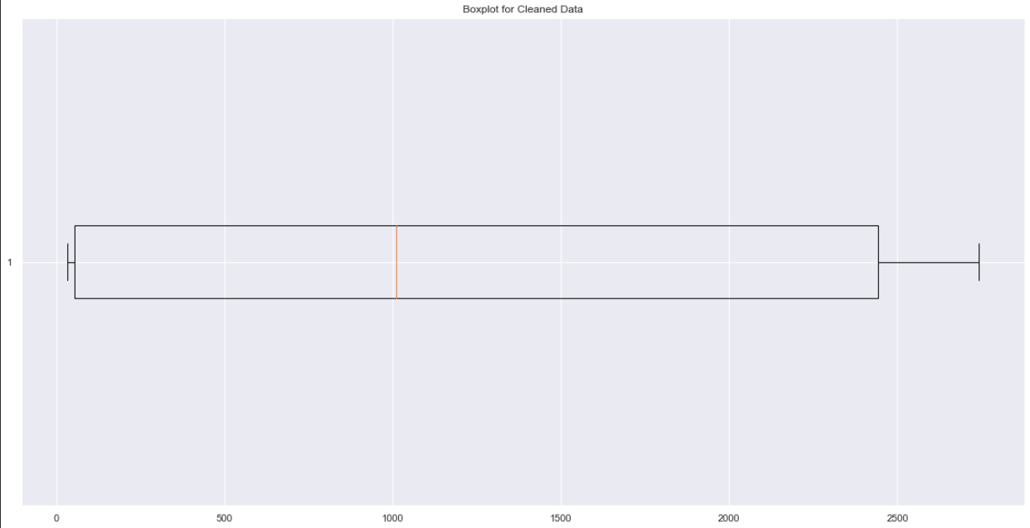
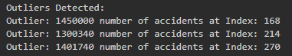
There were a total of 48 missing values in the dataset.
Additionally, there were 3 outliers identified using Statsmodels, we can see them circled.
The most common Road User Group is ‘Drivers, Riders or Cyclists’, with the second most common being pedestrians.
The most common cause of accident is the road user failing to keep a proper lookout, accounting for both fatal and non-fatal accidents

Slide 17
Data cleaning & Wrangling
Datasets: 11,12
df13 = pd.read_csv(r'./Datasets/(2) road-traffic-conditions/(11) Average Insurance Cost per Age Group.csv') display(df13.isna().sum()) display(df13) df13.to_csv('./Datasets/Cleaned Data/(11) cleaned.csv') url = 'https://api.data.gov.sg/v1/transport/carpark-availability' r = requests.get(url) r = r.json() carpark_info_arr = [] for info in r['items'][0]['carpark_data']: carpark_info_arr.append(info['carpark_info'][0]) df15 = pd.DataFrame(carpark_info_arr) df15 = df15.drop('lot_type', axis=1) display(df15) df15 = df15.astype({"total_lots": int,'lots_available':int}) #check data fit stockModel = sm.OLS.from_formula("total_lots ~ lots_available", data=df15).fit() stockPredicts = stockModel.predict() #print data analysis output print(stockModel.params) print(stockModel.summary()) x=df15['total_lots'] y=df15['lots_available'] plt.scatter(y=y, x=x) # best fit line Y = C + M * X m,c = np.polyfit(x, y, deg=1) plt.plot(x, c+m*x, 'r-') plt.xlabel('Total Lots Present') plt.ylabel('Total Lots Available') plt.show() #recheck data for outliers z_scores = stats.zscore(df15['total_lots']) #use Z score to find outliers in data abs_z_scores = np.abs(z_scores).to_frame() filtered_entries = (abs_z_scores < 3).all(axis=1) df_keys = filtered_entries[filtered_entries==False].keys() print('Outliers Detected: ') for key in df_keys: print(f"Outlier: {int(df15.loc[key,'total_lots'])} number of lots at Index: {key}") #reassess and re-plot data df16 = df15[filtered_entries] stockModel = sm.OLS.from_formula("total_lots ~ lots_available", data=df16).fit() stockPredicts = stockModel.predict() print(stockModel.params) print(stockModel.summary()) x=df16['total_lots'] y=df16['lots_available'] plt.scatter(y=y, x=x) # best fit line Y = C + M * X m,c = np.polyfit(x, y, deg=1) plt.plot(x, c+m*x, 'r-') plt.xlabel('Total Lots Present') plt.ylabel('Total Lots Available') plt.show() display(df16) df16.to_csv('./Datasets/Cleaned Data/(12) cleaned.csv')
Import
Import raw data from .CSV file
Clean
Assign names and labels
Declare
Declare arrays to store column-specific data
Store
Store column-specific data in arrays
Display
Display data for ease of viewing
Write
Write cleaned data to new .csv file for DAVI
.isna().sum() to check for null values
r = requests.get(url), r = r.json() to retrieve JSON Data from LTA API
stockModel = sm.OLS.from_formula("Total Lots ~ Lots Available", data=df_total).fit(), stockPredicts = stockModel.predict()
To check fit of data using linear regression
plt.scatter() to plot a scatter plot to view the relationships in the dataset
np.polyfit(x, y, deg=1) to plot best fit line
stats.zscore(df['number_of_accidents']) to find the Z score for each cell to measure outlier data
np.abs(z_scores).to_frame() to insert Z scores into DataFrame
(abs_z_scores < 3).all(axis=1) to get rid of all outlier data with Z score >3
df_total.to_frame().reset_index() to create a DataFrame and reset its index
.rename(columns={}) to rename columns for ease of understanding
display() to view the DataFrame, Linear Regression Model and Lineplot
read_csv() & to_csv() to read the original data and write the cleaned data for DAVI visualization analysis

Slide 18
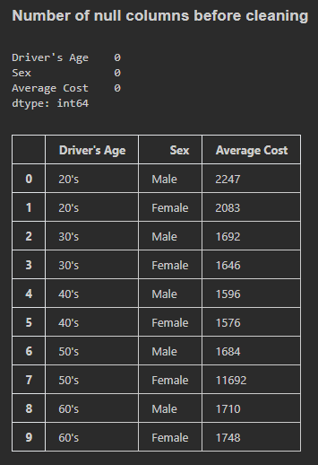
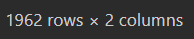

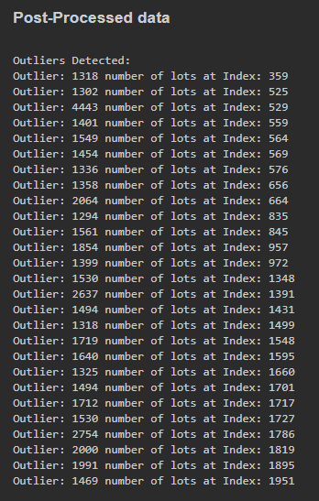
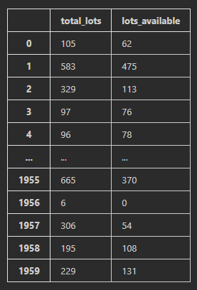
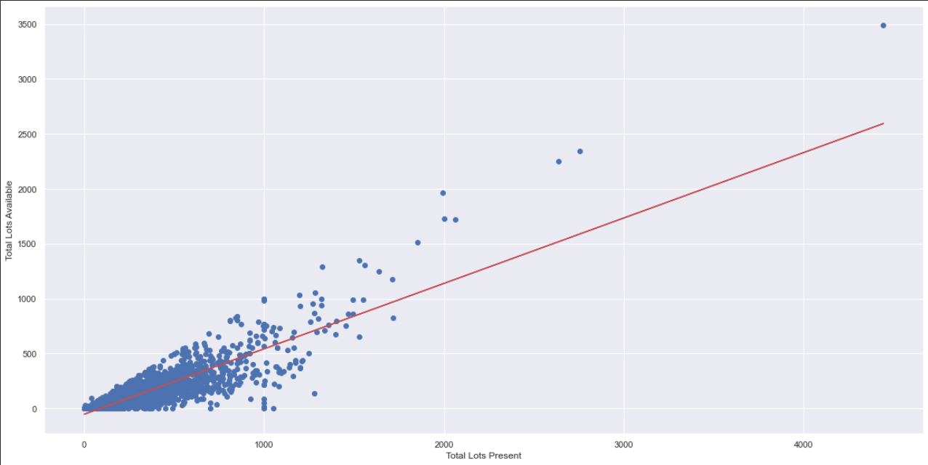
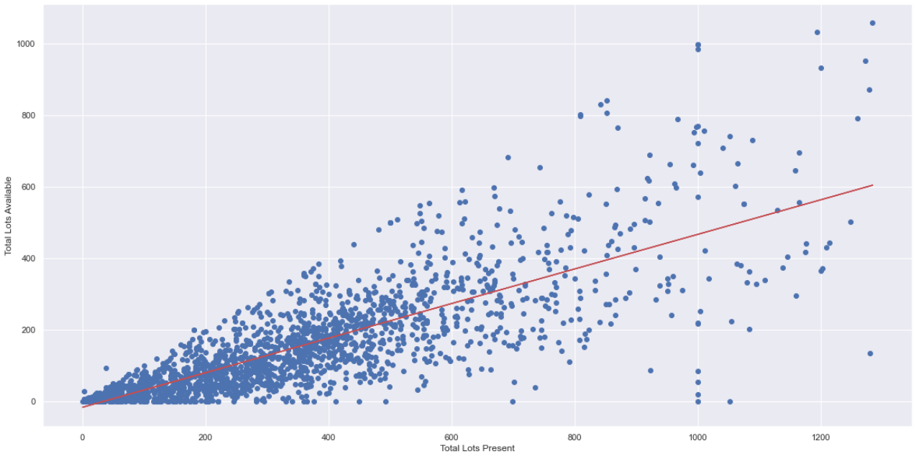
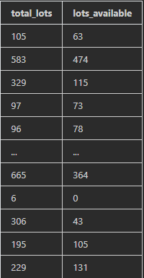
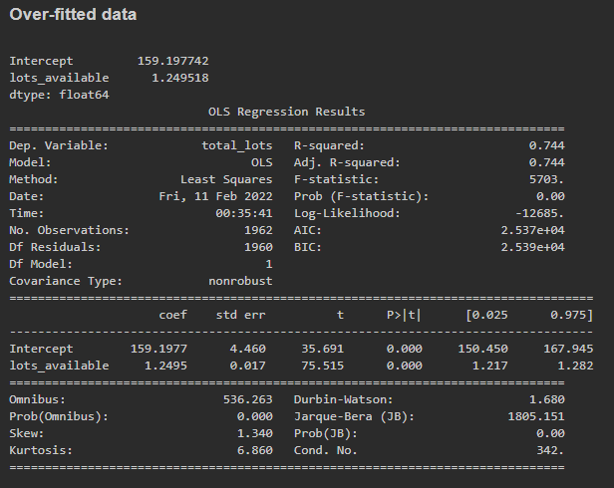
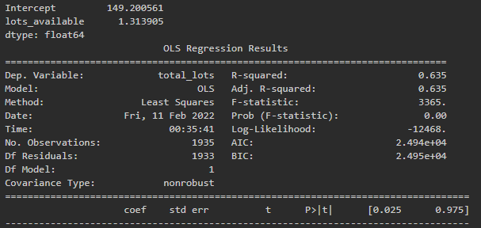
Before cleaning
After cleaning
Before
After
Before cleaning
After cleaning
Before cleaning
After cleaning

Slide 19
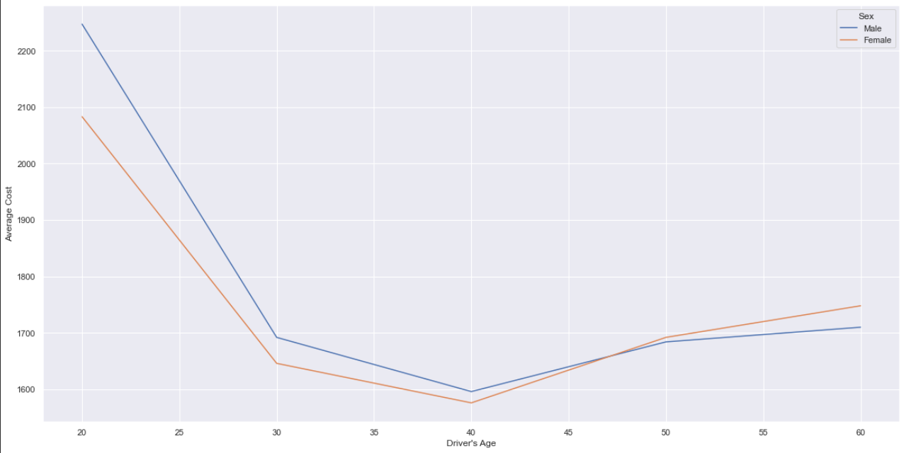
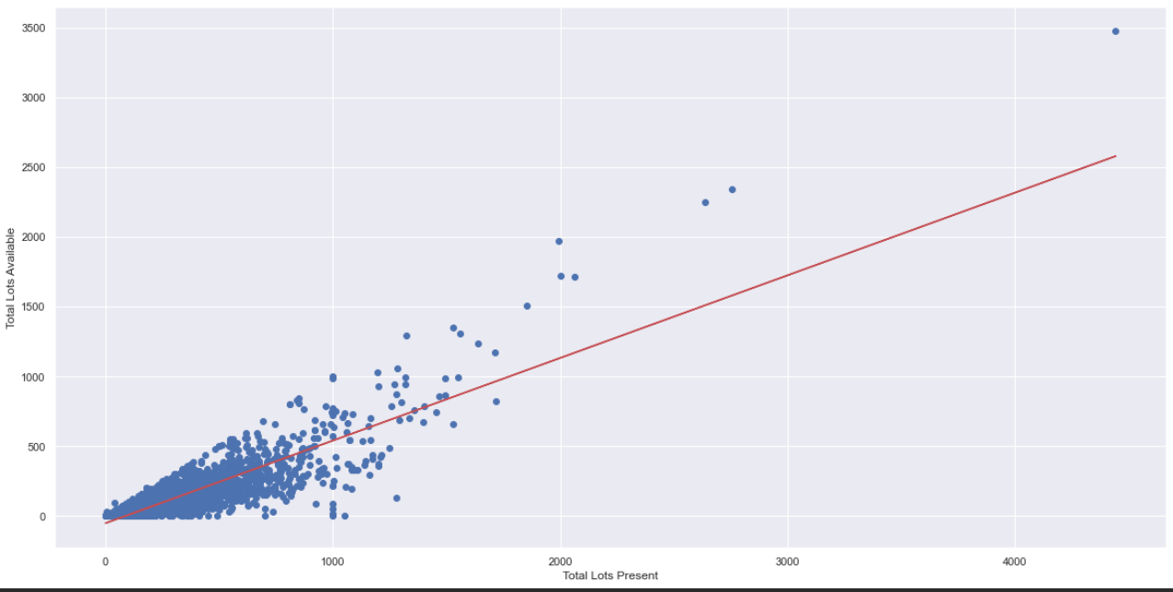
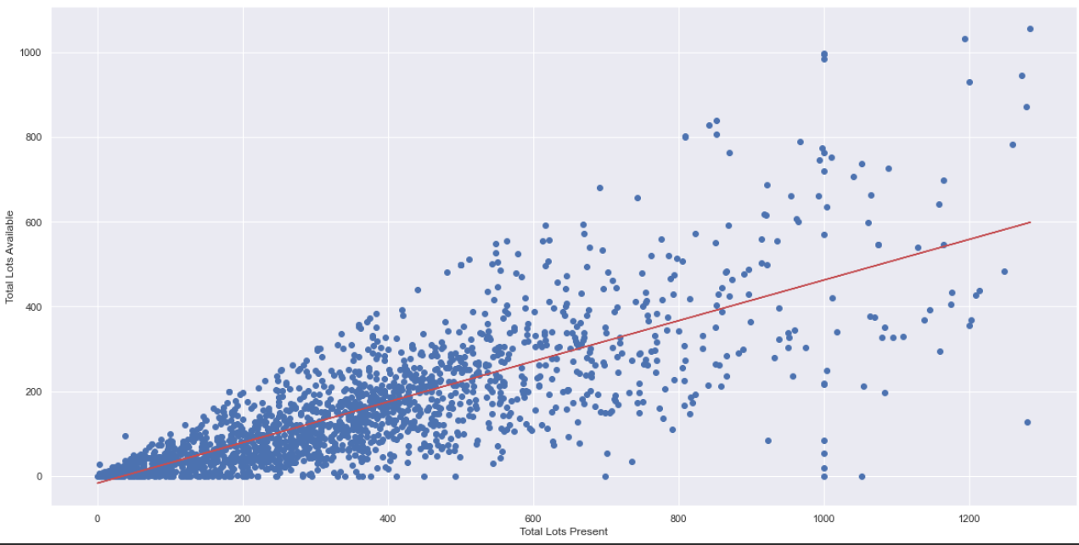
Explanation of insights
There were no empty columns in the dataset, however, there were more than 10 outliers that were identified using the Statsmodels library, and promptly removed.
We can observe that insurance prices for both male and female drivers are much higher at a younger age, at $2,165 for adults in their 20’s and begin to drop dramatically as they grow older. The average insurance for both genders begin to slowly increase as they grow older, due to other factors such as senior safety and road awareness playing a key part in increasing accident rates.
For the first scatterplot, we can observe certain outliers that are present within the data, however, after removing them and replotting the graph, we can begin to observe a certain trend going on.
That trend is heteroskedasticity (or heteroscedasticity), and it happens when the standard errors of a variable, monitored over a specific amount of time, are non-constant. (Hayes, 2022)
With heteroskedasticity, the tell-tale sign upon visual inspection of the residual errors is that they will tend to fan out over time, as depicted in the image above. (Hayes, 2022)
Heteroskedasticity is a violation of the assumptions for linear regression modeling, and so it can impact the validity of the analysis (Hayes, 2022) or in this case, the distribution of the number of parking lots present vs the number of parking lots available for public use.
We can conclude from the data that the greater the total number of parking lots present in a carpark, the less likely there is to be available parking spots, given the inconsistency of the distribution of data with time.

Slide 20
Data cleaning & Wrangling
Dataset: 13
df18 = pd.read_csv(r'./Datasets/(4) hdb-carpark-information/(13) hdb-carpark-information.csv') display(df18.isna().sum()) df18 = df18.fillna(method="ffill") #carparks are arranged geographically, hence it makes more sense to forward fill them with the surrounding carpark data display(df18.isna().sum()) df18 = df18.drop(['car_park_no','address'],axis=1) df18_levels = df18[df18.car_park_decks>0] df18_gantry = df18[df18.gantry_height>0] display(df18) fig, axs = plt.subplots(2,2) histplot1 = sns.histplot(ax=axs[0,0],data=df18_levels['car_park_decks'],kde=True) #distribution of levels where levels > 0 smplot1 = sm.qqplot(df18_levels['car_park_decks'],ax=axs[0,1],line='s',markersize=1) histplot2 = sns.histplot(data=df18_gantry['gantry_height'],kde=True,color='red',ax=axs[1,0]) #distribution of gantry height where levels > 0 smplot2 = sm.qqplot(df18_gantry['gantry_height'],ax=axs[1,1],line='s',markersize=1) histplot1.set_xlabel('Distribution of Car Park Decks') histplot2.set_xlabel('Distribution of Car Park Gantry Height') fig.tight_layout() plt.show() df18.to_csv('./Datasets/Cleaned Data/(13) cleaned.csv') carpark_pie ={} parking_type_pie = {} for carpark_type in np.unique(df18['car_park_type']): carpark_pie[carpark_type] = df18['car_park_type'].value_counts()[carpark_type] for parking_type in np.unique(df18['type_of_parking_system']): parking_type_pie[parking_type] = df18['type_of_parking_system'].value_counts()[parking_type] # Data to plot labels = [] sizes = [] for x, y in carpark_pie.items(): labels.append(x) sizes.append(y) print(labels,sizes) # Data to plot labels1 = [] sizes1 = [] for x, y in parking_type_pie.items(): labels1.append(x) sizes1.append(y) print(labels1,sizes1)
# Plot tree_frame_df = pd.DataFrame({'sizes':sizes,'labels':labels}) colors=['#70D6FF','#FF70A6','#FF9770','#FFD670','#26532B'] g = squarify.plot(sizes=tree_frame_df['sizes'], alpha=1, color=colors,pad=True) plt.legend(handles=g.containers[0], labels=labels) g.get_xaxis().set_visible(False) g.get_yaxis().set_visible(False) plt.show() #plot plt.pie(x=sizes1,labels=labels1) plt.show()
Import
Import raw data from .CSV file
Clean
Assign names and labels
Declare
Declare arrays to store column-specific data
Store
Store column-specific data in arrays
Display
Display data for ease of viewing
Write
Write cleaned data to new .csv file for DAVI
.isna().sum() to check for null values
np.unique(df[""]) to retrieve unique years
dict[key] = df[column_name].value_counts()[column_value] more efficiently count length of data, as opposed to len()
df_total.to_frame().reset_index() to create a DataFrame and reset its index
sns.hisplot() to plot histogram to show distribution of data
sm.qqplot() to plot probability distribution plot to analyse distribution of data
squarify.plot() to view percentage distribution across all different car park types
read_csv() & to_csv() to read the original data and write the cleaned data for DAVI visualization analysis

Slide 21
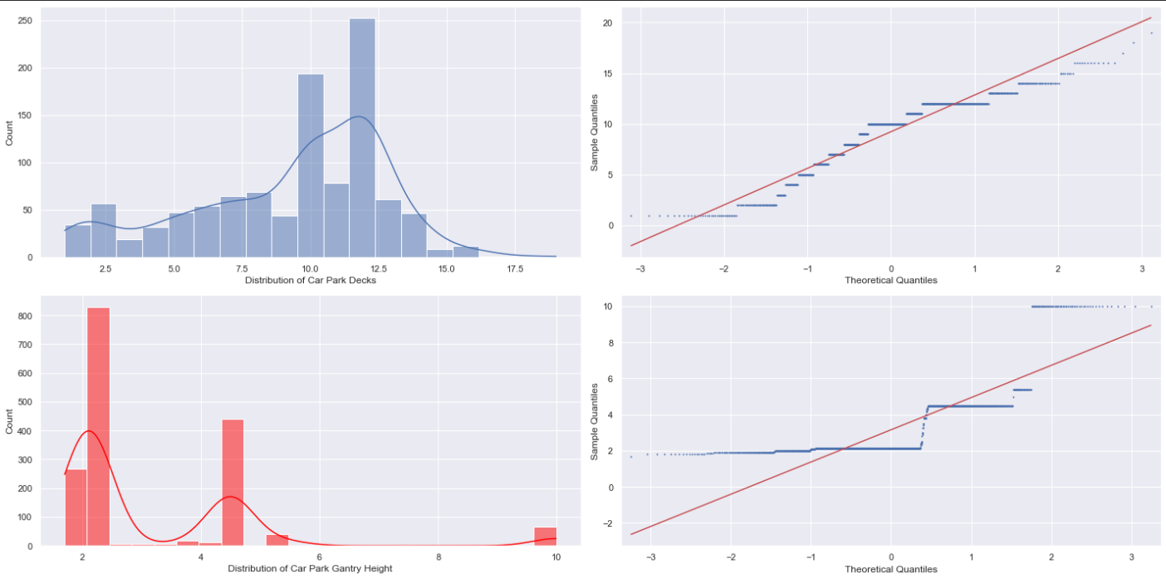
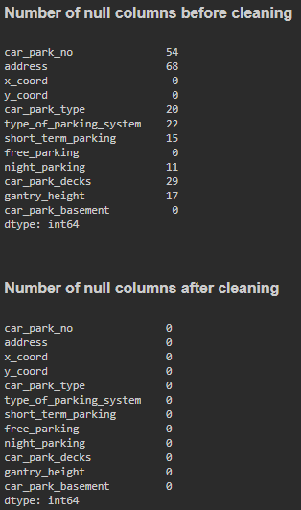
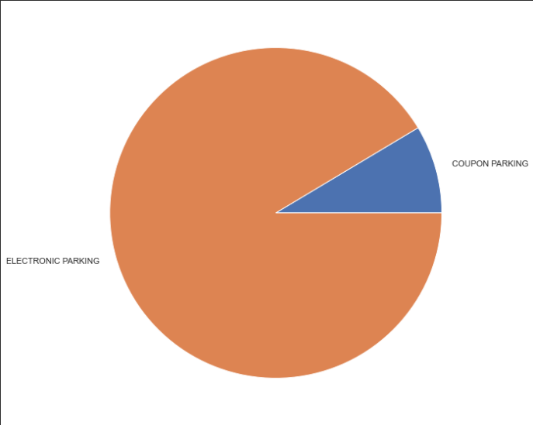
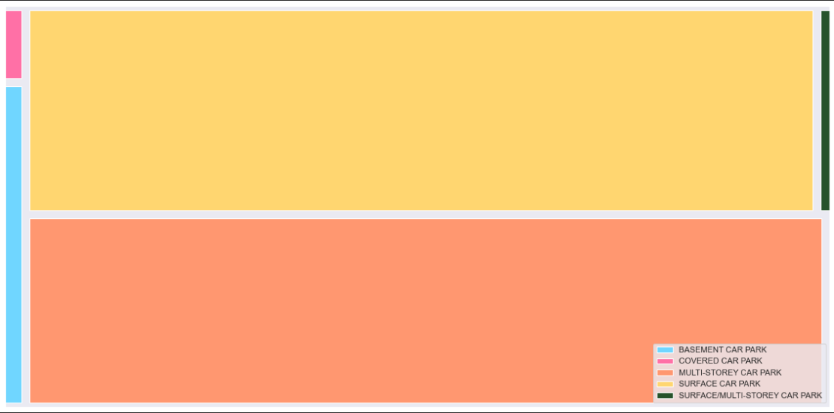
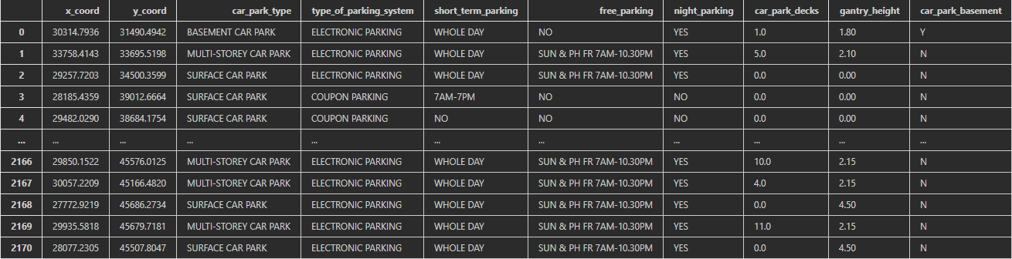

Slide 22
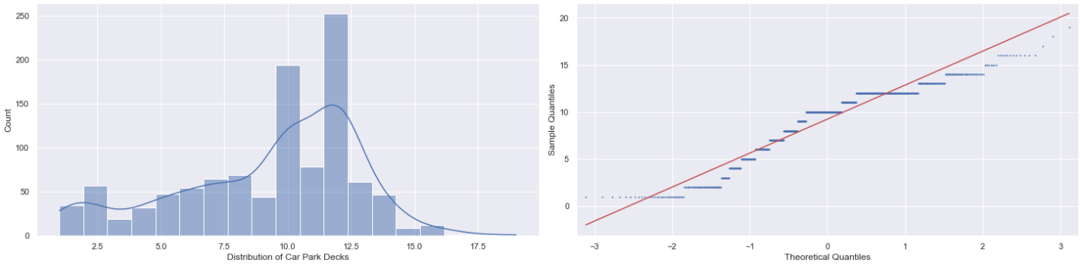
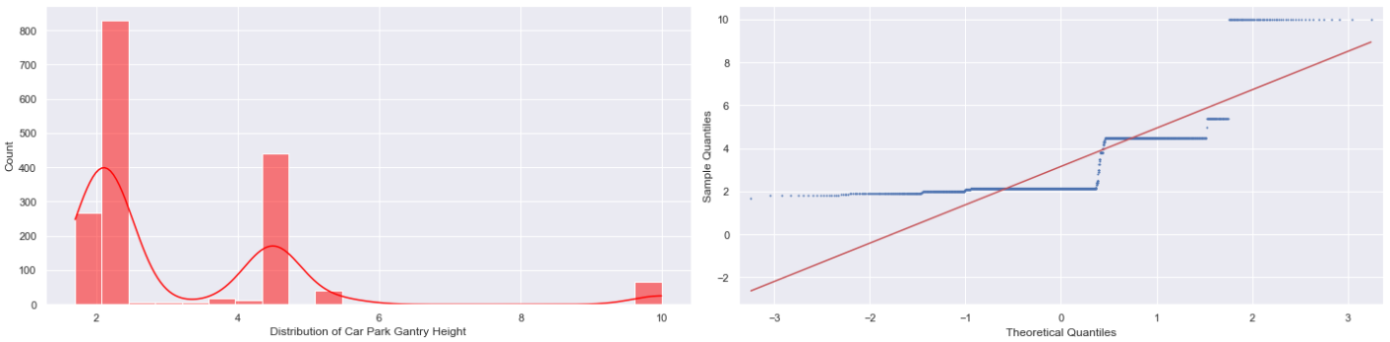
Explanation of insights
On a Q-Q plot under-dispersed data appears S shaped:
Under-dispersed data has a reduced number of outliers (i.e., the distribution has thinner tails than a normal distribution). Under-dispersed data is also known as having a platykurtic distribution and as having negative excess kurtosis. (Yearsley, 2022)
We can observe that there is a slight left-skewed distribution of Car Park Decks, allowing us to conclude that most Car Parks have decks that are 10 levels and greater, with the most common number of levels being 12
Note that when the data points are few, the Q-Q plot does not perform very precisely, and it fails to give a conclusive answer. But when we have an ample amount of data points and plot a Q-Q plot using a large data set, it gives us a significant result to conclude any result about the type of distribution.
Hence, since this distribution is far from normal, and the result derived from data is not conclusive nor does it fit normal distribution, the results of this data is therefore inconclusive and requires more data for further study.

Slide 23
Conclusion of insights
What are the most popular brand of cars sold and their respective models? How much do I have to pay for COE?
The most popular brand is Toyota, with online research indicating the most popular model to be the Corolla (Ashraf, 2022)
What road facilities am I provided with as a car buyer?
Annually-increasing road length
Annually increasing transport facilities and services such as Vehicular Bridges, Vehicle Underpass Tunnels, Traffic Lights etc.
How much are average fuel prices?
Average fuel prices are about $3.10 per liter, however due to volatile and unpredictable market conditions, said values may be prone to fluctuation.
How congested is Singapore? How many cars are on the road and how fast can I drive?
In terms of jam density, there is a 69.5% possibility to be caught in a jam in Singapore, if we consider the average number of vehicles per km in a jam to be 400.
Up by 1.4km/h since 2005, you can drive at an average speed of 64.1 Km/h on expressways, and 28.9 Km/h on arterial roads such as Orchard Road.
What are the most common accidents? If I get into an accident, what are the average vehicle insurance prices
The most common accidents occur when Drivers, Riders or Cyclists fail to keep a proper lookout on the road.
Such accidents require insurance prices that vary from age group to age group, with the most expensive being $2,247 for male adults in their 20’s, and the lowest being $1,576 for female adults in their 40’s.
After I’m done driving, where do I park my car?
The most common and easily accessible carparks available for usage are 10-12 deck multi-storey carparks that offer electronic parking.

Slide 24
credits
Hayes, A., 2022. Heteroskedasticity. [online] Investopedia. Available at: https://www.investopedia.com/terms/h/heteroskedasticity.asp [Accessed 10 February 2022]
Ashraf, Y., 2022. The world’s best-selling cars. [online] Autoexpress.co.uk. Available at: https://www.autoexpress.co.uk/best-cars-vans/33872/worlds-best-selling-cars [Accessed 10 February 2022]
V.L. Knoop and W. Daamen (2017). "Automatic fitting procedure for the fundamental diagram". Transportmetrica B: Transport Dynamics. 5 (2): 133–148. doi:10.1080/21680566.2016.1256239. [Accessed 10 February 2022]

